Slide 1
FTP
Asst.Drusawin Vongpramate
Information Technology
Buriram Rajabhat University

Slide 2
FTP : file transfer protocol
The File Transfer Protocol (FTP) is a standard network protocol used for the transfer of computer files between a client and server on a computer network.
pure-ftpd (very secure FTP daemon) is an FTP server for Unix-like systems, including Linux. It is licensed under the GNU General Public License. It supports IPv6 and SSL. vsftpd supports explicit (since 2.0.0) and implicit (since 2.1.0) FTPS. vsftpd is the default FTP server in the Ubuntu, CentOS, Fedora, NimbleX, Slackware and RHEL Linux distributions.

Slide 3
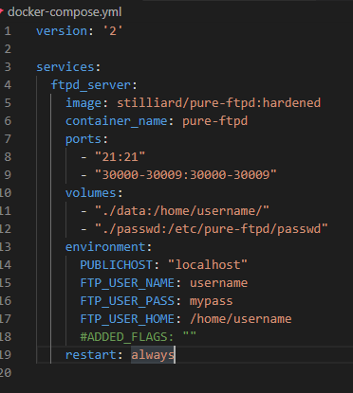
FTP : Server
Step 1 : Config docker-compose.yml

Slide 4
FTP : Server
Step 2 : Run docker
>> docker-compose up // -d for demon
>> docker ps
Step 3 : Config service
>> docker exec -it ftpd_server /bin/bash
//list all user
$ cat /etc/passwd

Slide 5
FTP : Server
Step 3 : Add more user
$ pure-pw useradd bru -f /etc/pure-ftpd/passwd/pureftpd.passwd -m -u ftpuser -d /home/ftpusers/ bru
//change password
$ pure-pw passwd bru -f /etc/pure-ftpd/passwd/pureftpd.passwd -m
Step 4 : Stop service
//non-demon use Ctrl+C
>> docker-compose stop

Slide 6
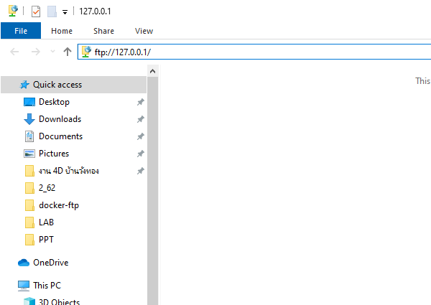
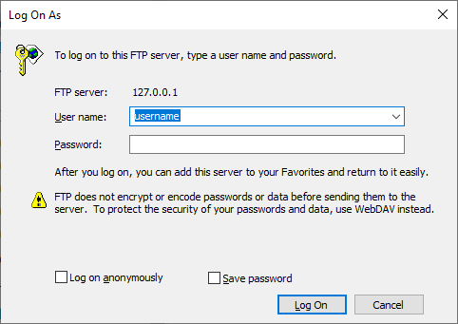
FTP : Client
test Client at ftp://127.0.0.1 or Other IP

Slide 7
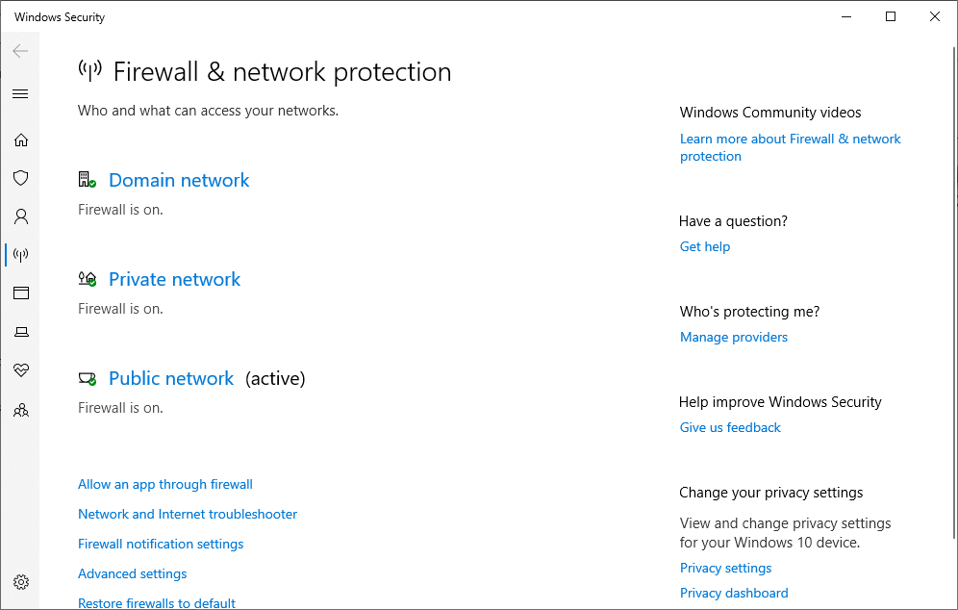
Firewall

Slide 8
Q & A

